Slide 1

New Testament Chronology
Dr. Rick Griffith • Jordan Evangelical Theological Seminary • BibleStudyDownloads.org

Slide 2
The Gospels
48
Matthew
Mark
Luke
John
NIV Study Bible, 1471
The word "Gospel" comes from the Old English "God-spell." It translates the Greek word for "good news."
In antiquity king's heralds announced "glad tidings" of the king's birthday throughout the cities of the realm.
It has the same meaning in our New Testament. The four Gospels announce the glad tidings about Jesus.
The ancient world knew of history, poetry, prophecy and letters. But a "gospel" was new to them.
Here, inspired writers gave more than just history. They also created faith (John 20:30-31) by proclaiming the good news that, just as the OT had promised, God had sent His Messiah to the world.

Slide 3
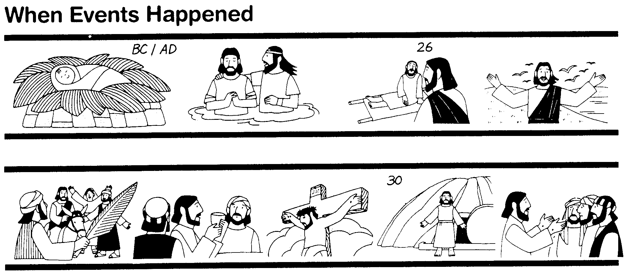
The Synoptics
Why are there four Gospels? Perhaps for the same reason different descriptions of a finely cut jewel would appeal to different people. Matthew describes one facet of the life of Christ, Mark another, and Luke a third.
48
Matthew
Mark
Luke
John
These three Gospels are so much alike that they are called Synoptic ("see with," or "see alike") Gospels. They all look at Christ's life from a historical perspective. On the other hand, John's Gospel dwells more on the inner meaning of Jesus' life and teachings.
NIV Study Bible, 1471

Slide 4
Synoptic Similarities
49
NIV Study Bible, 1471
Matthew, Mark and Luke are noticeably similar, while John is quite different.
How do the first three Gospels agree?
  Language
  Material they include
  General order of the events and sayings from Christ’s life
The math facts:
  91 percent of Mark is found in Matthew
  53 percent of Mark is found in Luke
Such agreement raises questions as to the origin of the Synoptic Gospels. Did the authors rely on a common source? Were they interdependent?

Slide 5


THAT STRANGE SOUNDING WORD…
52
SYNOPTIC:
1
MATTHEW
2
MARK
TO:
JEWS
TO:
ROMANS
AS:
KING
AS:
SERVANT
WHAT
HE:
SAID
WHAT
HE:
DID
SYNOPTIC:
“TO SEE TOGETHER”
“TO
SEE TOGETHER”
3
LUKE
TO:
GREEKS
AS:
GOD/MAN
WHAT
HE:
FELT
John Fryman, “The Bible…Basically” Seminar
20
3
Notes:
Now comes that word that's a strange one to many...
//// SYNOPTIC…meaning…
//// … “TO SEE TOGETHER”…add these words to that triangle shape on your study help.
//// It is a term from Greek roots that means seeing a group of things together... from the same general perspective. One word that, again, helps organize and categorize the enormous factual base that makes up our Bible.

Slide 6
FRAMING THE GOSPELS…
51a
1
MATTHEW
2
MARK
3
LUKE
4
JOHN
16
3
Notes:
Each of the frames now gets its name... MATTHEW in the first...
//// MARK, second...
//// LUKE, third...and finally, the fourth…
//// JOHN, the names of the Gospels in the order of their appearance in the New Testament canon...the official collection of Biblical writings.

Slide 7
THE AUDIENCES FOR THE GOSPELS…
51a
1
MATTHEW
2
MARK
TO:
JEWS
TO:
ROMANS
3
LUKE
4
JOHN
TO:
GREEKS
TO:
CHURCH
17
4
Notes:
Now comes an idea endorsed by Biblical scholars around the world…having to do with the audiences TO WHICH each Gospel was written.
For instance…
//// MATTHEW penned his work specifically toward his brothers and sisters in the Jewish audience. He makes repeated references to a regnant Jesus, seeing him as the Messiah and the King of the Chosen People.
//// For MARK, his work is widely regarded as directed toward the Romans, then occupying his native land and into the farther parts of the ancient world. MARK is brief, to the point. And, in fact, repeatedly he uses such term as "straightway" in early translations…all in a get-the-job-done mentality, which characterized the Roman way of thinking and doing things.
//// While LUKE, the physician, is the highly intellectual Greek who accompanied Paul on his tours. For LUKE, his Gospel audience was the Greeks, and in other words, to the Gentile world in general.
Also as the author of The Acts, Luke set down for all time a detailed account of the development of the early church and its wide-spread missionary ministries, to which he was a witness.
//// Finally, we come to the gospel of JOHN, whose audience differs markedly from the first three. John is written directly to UNBELIEVERS, AND REACHING THEM THROUGH THE COMMUNICATION CHANNEL OF THAT NEW ORGANISM, THE CHURCH. In fact, when you read John's gospel, you are struck with the fact that his work carries with it a somewhat mystical quality, certainly not the quick, even terse recounting of facts as we find in Mark's Gospel. John's audience –– the Church itself, the members of the new Organism, bathed in the redemptive love of Christ –– receives his brilliant articulation of the impact of the coming of the Holy Spirit, now –after the Day of Pentecost -- having taken up permanent residence in the heart of each new believer.
So there are four individual audiences to which the Gospels were specifically directed at the time of their writing. That one insight, alone, gives a new way to categorize and individualize the Gospel writings.

Slide 8
…PORTRAYING JESUS AS…
51a
2
1
2
1
MATTHEW
MARK
TO:
JEWS
TO:
ROMANS
AS:
KING
AS:
SERVANT
4
3
4
3
JOHN
LUKE
JOHN
GREEKS
CHURCH
TO:
TO:
CHURCH
TO:
TO:
AS:
GOD/MAN
AS:
GOD
18
4
Notes:
Another question: How does each Gospel portray The Lord as a Man and as Immanuel, “God With Us?”
//// For MATTHEW...Christ is seen as King of the Jews. Repeatedly Matthew describes how Jesus is the fulfillment of Old Testament Scripture. Matthew makes wide use of Jewish terminology of royalty.
//// For MARK...He is seen as the Servant of all...some say the Suffering Servant, and traditionally associated with an audience in Rome and among the widespread Roman world.
//// LUKE sees Christ as the God-Man -- truly God and truly Man. Luke shows the Gentiles that Christ is the perfect man to which they aspired.
//// Finally, John's Gospel. Clearly and above all else...JOHN portrays Christ as God Himself. JOHN uses his pen to communicate the mystery and the power of the Messiah. Why? Because John experienced a particular closeness to the Master, one that was apparently unique among the disciples. Remember too that this was this same JOHN who was destined to see and write down the great End-Times vision we know as The Revelation.

Slide 9
THE MESSAGE IN A NUTSHELL…
51a
1
MATTHEW
2
MARK
TO:
JEWS
TO:
ROMANS
AS:
KING
AS:
SERVANT
WHAT
HE:
WHAT
HE:
SAID
DID
3
LUKE
4
JOHN
TO:
GREEKS
TO:
CHURCH
AS:
GOD/MAN
AS:
GOD
WHAT
HE:
WHAT
HE:
FELT
MEANT
19
5
Notes:
Here is a last set of interesting ideas, with thanks to some anonymous believer who developed them years ago.
//// Call it “the message in a nutshell.” Question: what is the one single word that might characterize the message of each Gospel?
//// For MATTHEW...that book tells us what Jesus Christ SAID.
//// MARK tells us what He DID.
//// LUKE shows us clearly what the Messiah FELT.
//// And JOHN, with enormous clarity, tells us what Christ MEANT!
What he SAID...what He DID...what He FELT...and what He MEANT!
These single-word ideas help us to tightly focus on the remarkable differences that exist among the Gospel writings. For many Bible readers, such distinctives are unfamiliar territory.

Slide 10
THE SYNOPTICS: “TO SEE TOGETHER”
52
1
MATTHEW
2
MARK
TO:
JEWS
TO:
ROMANS
AS:
KING
AS:
SERVANT
WHAT
HE:
SAID
WHAT
HE:
DID
∑
3
LUKE
4
JOHN
TO:
GREEKS
CHURCH
TO:
AS:
GOD/MAN
AS:
GOD
WHAT
HE:
FELT
WHAT
HE:
MEANT
21
1
Notes:
Follow the arrows as they link together the gospels of MATTHEW, MARK and LUKE. Again…you'll notice that JOHN is not among them. Those three are the so-called SYNOPTIC Gospels...THEY ARE SEEN TOGETHER...in that these works take on that ground-level view of the human history of Jesus Christ just as he walked about Palestine in the days of his ministry. The Man…and his Mission among his People.
//// On the other hand…the Gospel of John –– seen here with the familiar mathematical SUMMA sign –– represents the summation of all that Jesus Christ MEANT –– the sum of all that he preached and demonstrated –– both publicly and privately. Seeing the Lord clearly as God Himself, John raises our spiritual horizon in ways that the first three gospels do not.

Slide 11
UNIQUE MATERIAL…
52
1
MATTHEW
2
MARK
7% unique!
Baptism
Lord's Supper
Birth
Genealogy
5000 fed
Passion
3
LUKE
4
JOHN
92% unique!
16
Notes:
Each of the Gospels say things that the others don't...
//// MATTHEW was believed by the early church to have written first...
//// MARK shares a lot of material with Matthew, such as Christ's baptism and supper...
//// LUKE also has much overlap with Matthew and Mark, such as Christ's baptism and supper—but only Matthew and Luke record Christ's birth and genealogy. However, the fourth…
//// JOHN, stands alone in terms of its material. Only 8% of it repeats stories from the others—such as the feeding of the 5000, and, of course, His death and resurrection.
//// But the remaining 91% of JOHN you will find only in JOHN.

Slide 12

The Synoptic Problem
49
Matthew, Mark & Luke in a nutshell:
How do we explain their similarities?
How do we explain their differences?

Slide 13
Marcan Priority Diagrammed
51
51
Mark
661
1068
1149
500
350
Matthew
Luke
Numbers indicate the verses in each proposed source
235
333
Q
564
M
L

Slide 14

Dating the Synoptic Gospels
49
Adapted from the NIV Study Bible, 1431
MARK
MATTHEW
LUKE
MARK
MATTHEW
LUKE
ASSUMPTION A:
ASSUMPTION B:
Matthew and Luke used Mark as a source
Matthew and Luke did not use Mark as a source
View #1
View #1
Mark written in the 50s or early 60s
Mark could have been written anytime between 50 and 70
(1) Matthew written in late 50s or the 60s
View #2
(2) Luke written 59-63
Mark written 65-70
View #2
(1) Matthew written early 50s (see Matthew notes)
Mark written 65-70
(1) Matthew written in the 70s
(2) Luke written 59-63 (see Luke notes)
(2) Luke written in the 70s
Taught in this class

Slide 15
Solutions to the Synoptic Problem
49
Questions like these constitute what is known as the Synoptic Problem. Several solutions have been advanced:
The use of oral tradition. Some have thought that tradition had become so stereotyped that it provided a common source from which all the Gospel writers drew.
The use of an early Gospel. Some have postulated that the Synoptic authors all had access to an earlier Gospel, now lost.
The use of written fragments. Some have assumed that written fragments had been composed concerning various events from the life of Christ and that these were used by the Synoptic authors.
Mutual dependence. Some have suggested that the Synoptic writers drew from each other with the result that what they wrote was often very similar.
NIV Study Bible, 1431

Slide 16
Solutions to the Synoptic Problem
49
The use of two major sources. The most common view currently is that Mark and a hypothetical document, called Quelle (German for "source") or Q, were used by Matthew and Luke as sources for most of the materials included in their Gospels.
The priority and use of Matthew. Another view suggests that the other two Synoptics drew from Matthew as their main source.
A combination of most of the above. This theory assumes that the authors of the Synoptic Gospels made use of oral tradition, written fragments, mutual dependence on other Synoptic writers or on their Gospels, and the testimony of eyewitnesses.
NIV Study Bible, 1431

Slide 17
Two-Source Hypothesis
50
Q
AD 50
Mark
AD 65
Matthew
Luke

Slide 18
Four-Source Hypothesis
50
M
Jerusalem
AD 60-65
Mark
Rome
AD 65
Q
Antioch
AD 50
L
Caesarea
Proto-Luke
Matthew
Antioch
AD 85
Luke
Caesarea, Corinth?
AD 60, AD 80
Antiochene
Tradition
Source of
Luke 1-2

Slide 19
When I Think They Were Written…
52
1
MATTHEW
2
MARK
TO:
JEWS
TO:
ROMANS
The A.D.40s
A.D. 64-68
AS:
KING
AS:
SERVANT
WHAT
HE:
WHAT
HE:
SAID
DID
3
LUKE
4
JOHN
GREEKS
CHURCH
A.D. 57-59
A.D. 69 AFTER THE SYNOPTICS
TO:
TO:
AS:
GOD/MAN
AS:
GOD
WHAT
HE:
WHAT
HE:
FELT
MEANT
27
4
Notes:
Now…what about the dates of the writing of these crucial documents? And here we are left to our best scholarly guesses. There will ALWAYS be argument here. But some of the best guesses, based on decades of academic research and study are these – in suggested order…
//// MATTHEW…composed sometime during the A.D. 40s…
//// LUKE is suggested as next, between the years A.D. 57 and 59 A.D…
//// Mark…in the next decade…between 64 and 68…
//// and finally…John’s Gospel…around A.D. 69….but certainly after the Synoptics were set down. Again, you will always find disagreement on these dates. However, these dates are from the research of well-known Christian scholars and teachers.

Slide 20

Date Options for John’s Gospel
109
Authorship is easier to determine than when John wrote. Three periods have been proposed for the date of the Gospel:
Late First Century
Second Century
Before AD 70
33
Christ's
Death
70
Temple
Destroyed
95
John's
Death

Slide 21
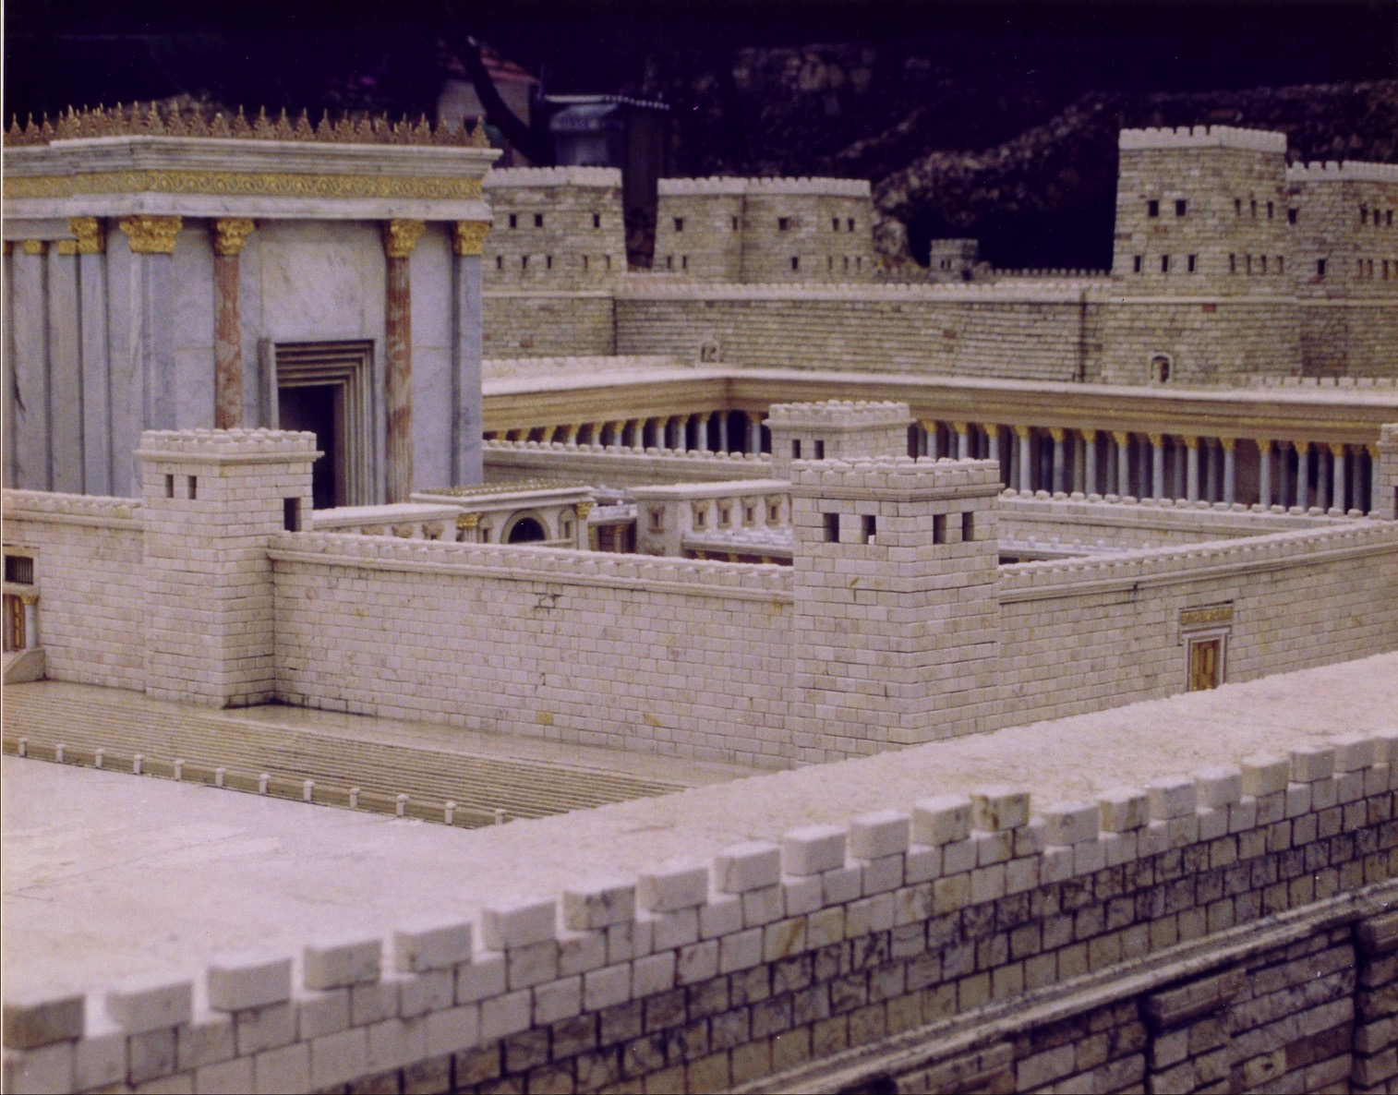
The Temple Stood Until AD 70

Slide 22
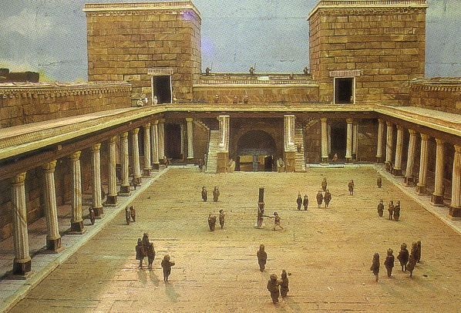
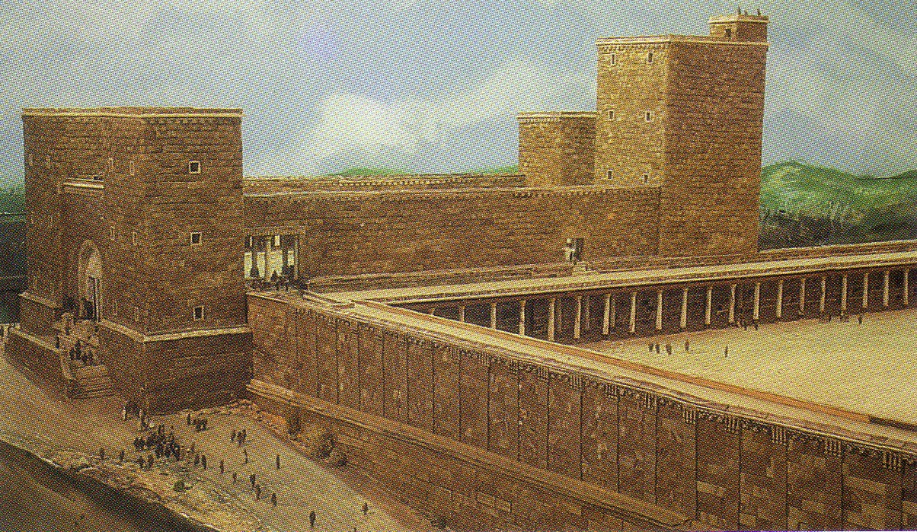
Antonia Fortress

Slide 23
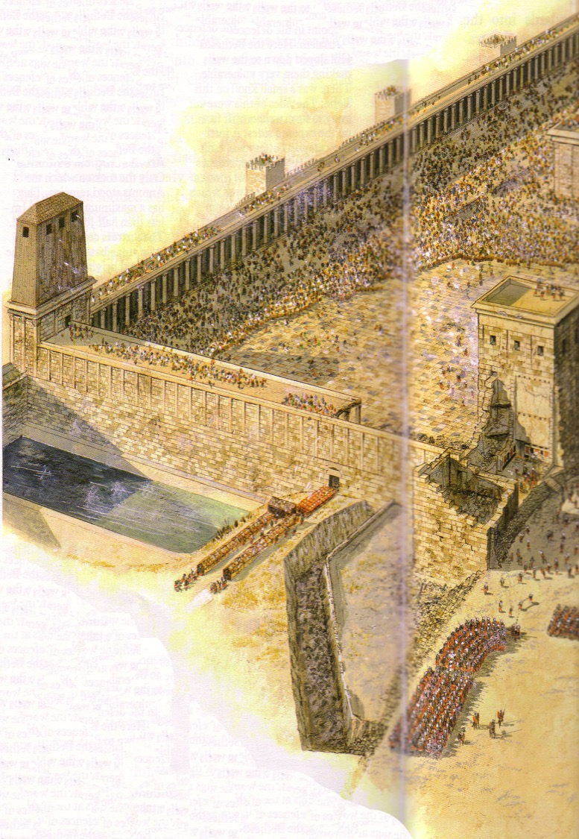
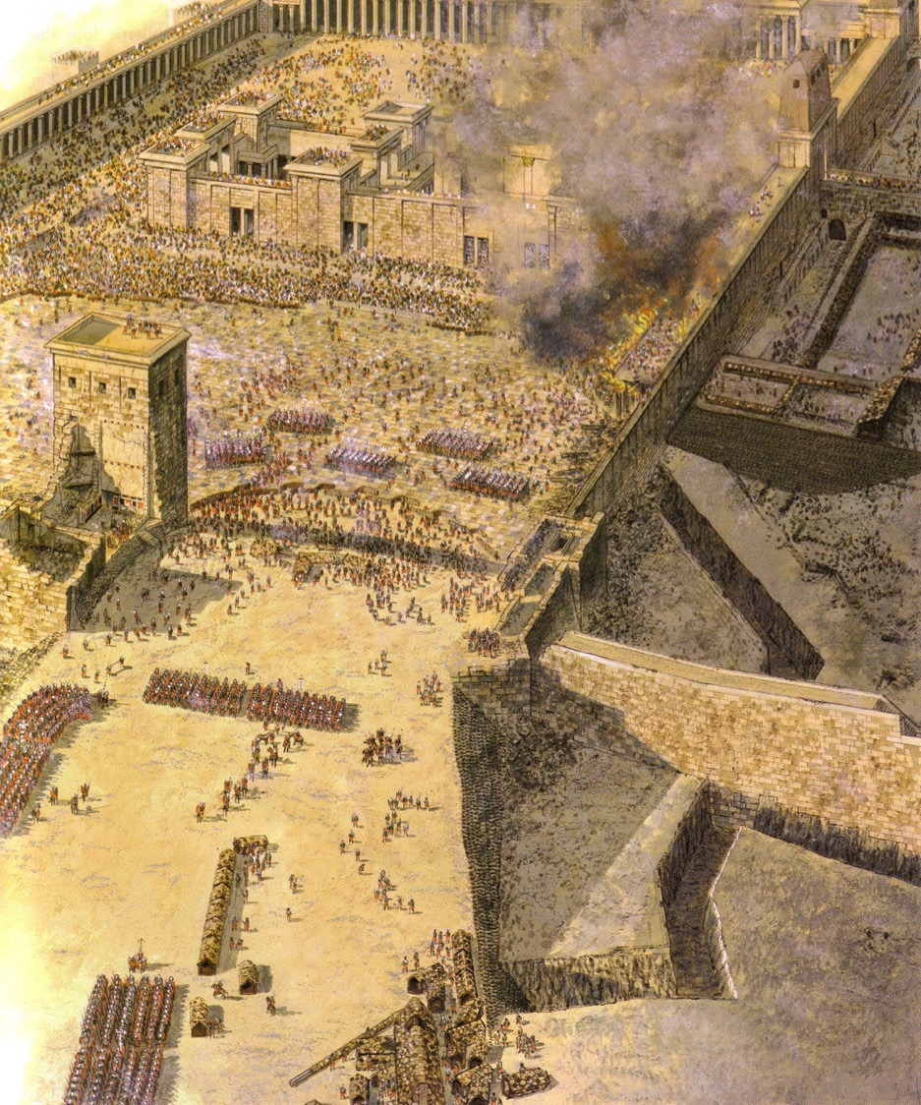
Temple Assault
Sept AD 70
Sheep Pool

Slide 24
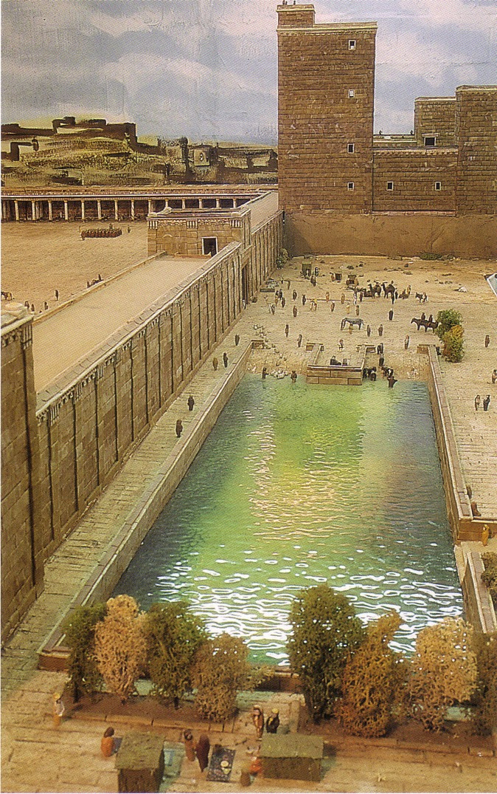
The Pool of Israel
(Sheep Pool south of Pool of Bethesda)

Slide 25
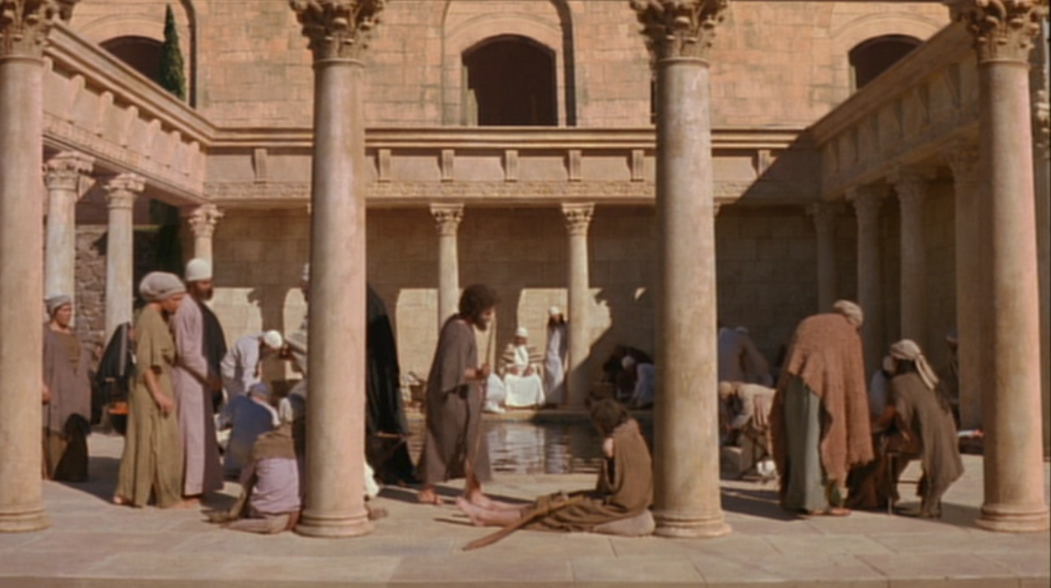
Pool of Bethesda
“Now there is in Jerusalem near the Sheep Gate a pool… called Bethesda…”
John 5:2

Slide 26
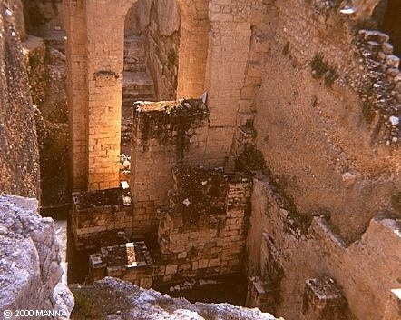
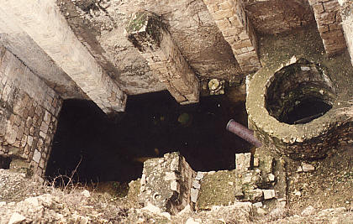
Pool of Bethesda
“Now there is in Jerusalem near the Sheep Gate a pool… called Bethesda…”
John 5:2

Slide 27
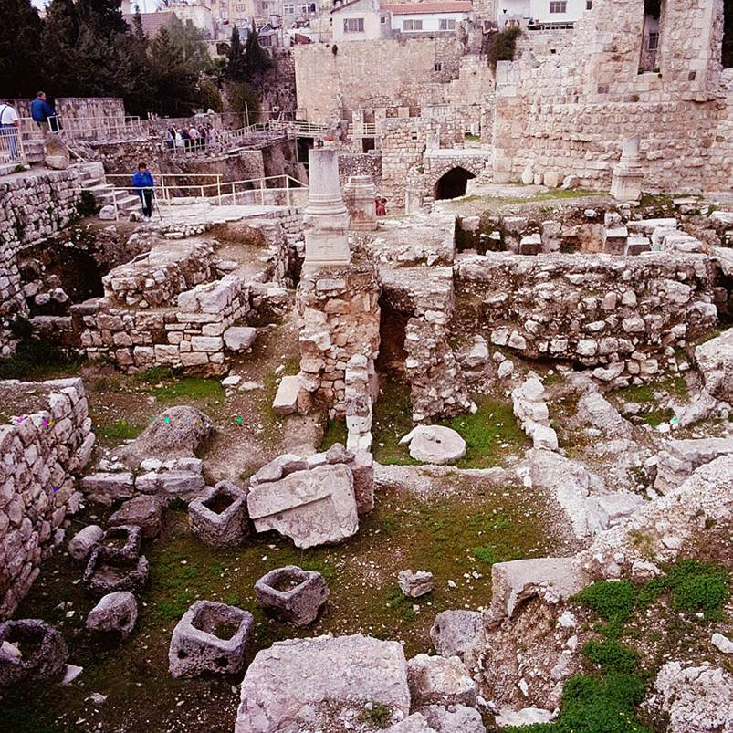
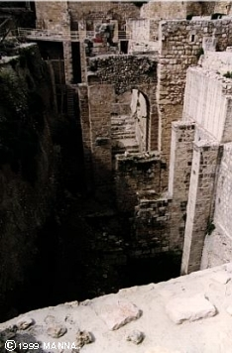
Pool of Bethesda Ruins

Slide 28
The Four Gospels Compared
52
 | Matthew | Mark | Luke | John
Author | Matthew | Mark | Luke | John
Job before Saved | Tax Collector | None (Youth) | Medical Doctor | Fisherman
Race | Jew | Jew | Gentile | Jew
Office and / or Spiritual Gift | Apostle | Service or Pastoring | Service or Teaching | Apostle
Readers
Ethnically | Jewish | Roman | Gentile (Greek) | World
Interest | Signs (1 Cor. 1:22) |  | Wisdom (1 Cor. 1:22)
Spiritually | Unbelievers | Believers | Unbelievers | Unbelievers
Primary Need: | Messiah and Kingdom Offer | Model in Suffering (exhorts discipleship) | Universality (and kingdom expansion) | Deity

Slide 29
The Four Gospels Compared
52
 | Matthew | Mark | Luke | John
Date Written | 40s | 64-68 | 57-59 | late 60s
Place Written | Antioch or Syria | Rome | Caesarea or Rome | Ephesus
Place Sent | Palestine | Rome | To Theophilus | Asia, etc.
Jesus is… | King of Israel (Messiah) | Suffering Servant (Deity) | Ideal Man (Messiah) | Son of God (Deity)
Key Verse | 21:5 | 10:45 | 19:10 | 20:31
Themes | Law | Power | Grace | Glory
Literary Emphasis | Sermons | Miracles | Parables | Allegories
Arrangement | Topical | Chronological | Chronological | Topical
Genealogy | Abraham to Joseph | None | None | None

Slide 30
The Four Gospels Compared
52
 | Matthew | Mark | Luke | John
Scope | Birth to Resurrection | Ministry to Resurrection | Ministry to Resurrection | Ministry to Resurrection
Tone | Prophetic | Pastoral | Historical | Spiritual
Christ's Words | 60% | 42% | 50% | 50%
Chapters | 28 | 16 | 24 | 21
Verses | 1068 | 661 | 1149 | 878
Verses per Chap. | 38 | 41 | 48 | 42
OT Quotations | 53 | 36 | 25 | 20
OT Allusions | 76 | 27 | 42 | 105
OT References | 129 | 63 | 67 | 125
Unique Material | 42% | 7% | 59% | 92%
Broad Division | ------------------- Synoptic Gospels------------------- |  |  | Supplementary Gospel

Slide 31

How Well Do You Know the Life of Christ?
How Well Do You Know the Life of Christ?
53
4
Guest at Wedding
Can you number these events in chronological order?
6
Interview with Nicodemus
3
Enemy's 3 Temptations
7
Message on Mount
1
Birth in Bethlehem
5
Housecleaning the Temple (1st time)
10
Washing Disciples' Feet
8
Parables of Kingdom
2
Carpenter in Nazareth
9
Tomb of Lazarus
Terry Hall, Bible Panorama, 121

Slide 32
54
AN ALPHABETIZED LIFE OF JESUS (Adapted from Terry Hall, Bible Panorama, 139)
Angels [malaikat] | Luke 1:5-38; Matthew 1:18-25 | Nazareth, Jerusalem
Birth [kelahiran] | Luke 2:1-20; Matthew 2:1-12 | Bethlehem
Carpenter [tukang kayu] | Matthew 2:19-23; Luke 2:39-52 | Nazareth
Dove [merpati] | Matthew 3:11-17; Luke 3:15-23 | Jordan River
Enemy [musuh] | Matthew 4:1-11; Luke 4:1-13 | Wilderness, northeast Judea
Followers [pengikut] | John 1:19-51; Mark 3:14-19 | Perea, Galilee
Guest [tamu] | John 2:1-11 | Cana
Housecleaning [pembersihan Bait] | John 2:13-22 | Jerusalem
Interview [percakapan] | John 3:1-21 | Jerusalem
Jacob's well [sumur Yakub] | John 4:5-42 | Samaria
Kin [keluarga] | Luke 4:16-31 | Nazareth
Location [tempat] | Matthew 4:13-22 | Capernaum
Message [pesan] | Matthew 5–7 | Capernaum area
Nature [karakter] | Luke 7:1-35 | Capernaum area, Galilea
Opposition [penentang] | Matthew 12:22-50 | Capernaum
Parables [perumamaan] | Matthew 13:1-53; Mark 4:1-34 | Capernaum area
Question [pertanyaan] | Matthew 16:13-28; Luke 9:22-36 | Caesarea Philippi
Revelation [pewahyuan] | Matthew 17:1-13 | Iturea, Mt. Hermon
Stoning [dilempari batu] | John 10:22-39 | Jerusalem
Tomb [kubur] | John 11:1-54 | Bethany near Jerusalem
Upset [kekecewaan] | Matthew 21–23 | Jerusalem
Vision [penglihatan] | Matthew 24–25 | Jerusalem, Mt. Olivet
Washing [pembasuhan] | John 13 | Jerusalem, Upper Room
Xecution [penghukuman] | Matthew 26:30–27:56 | Jerusalem
Yes! [Ya] | Matthew 28; Luke 24:1-49 | Jerusalem, Judea, Galilea
Zion [Sion] | Luke 24:50-53; Acts 1:1-12 | Jerusalem, Mt. Olivet

Slide 33

Great Periods in the Life of Christ
55
“The Son of Man… came to minister and to give his life a ransom for many” (Mark 10:45)
Climactic Galilean
Early Samaritan
Later Samaritan
Early Judean
Later Judean
Early Perean
Later Perean
Opening Events
Closing Events
Preparation
Confirmation
Walk Thru the New Testament seminar (used with permission)

Slide 34

A Definitive Work

Slide 35
Dating the Birth of Christ
56
Date of Birth: ca. December 5 BC/January 4 BC
Jesus was born between these two dates:
Census of Quirinius/Cyrenius (Luke 2:1-5)
Death of
Herod the Great
(Matt. 2:1; Luke 1:5)
6 BC
29 March-11 April
4 BC
Harold W. Hoehner, Chronological Aspects of the Life of Christ (Zondervan, 1977), 114

Slide 36
Dating the Start of Christ's Ministry
56
Commencement of Ministry: ca. Autumn AD 29
Jesus probably began his ministry between these two dates:
15th YEAR OF THE REIGN OF TIBERIUS*
(Luke 3:1-3)
19 August
AD 28
31 December
AD 29
*Reckoned from either the Julian Calendar or Tiberius Regnal Year
Harold W. Hoehner, Chronological Aspects of the Life of Christ (Zondervan, 1977), 114

Slide 37
The Duration of Christ's Ministry
56
Autumn AD 29 – 3 April AD 33 (3.5 Years)
John alone notes three Passovers
Therefore, Christ's ministry was at least 2.5 years
Commencement of Christ's Ministry
Passover #1
April 7,
AD 30
Passover #2
Passover #3
April 25,
AD 32
Passover #4
April 3,
AD 33
Autumn
AD 29
John 2:13, 23
Unstated by John
Mark 2:23-28
Luke 6:1-5
Matthew 12:1-8
John 6:4
John 11:55–12:1
Harold W. Hoehner, Chronological Aspects of the Life of Christ (Zondervan, 1977), 114
Notes:
Christ's 3½ year ministry spanned four Passovers. However, the Synoptics mention only one Passover (#2 on this timeline), which could give the impression of only a year-old ministry. John fills in the details, though, by showing three other Passovers not mentioned by Matthew, Mark, or Luke.

Slide 38
Chronology of Jesus & Acts
38a
5/4 BC
1 BC
AD 1
14
29
30
33
35
Jesus
Born
–1 year–
Tiberius
Crowned
15th Yr.
Tiberius
–
John &
Jesus
Jesus
Died
Paul
Believed
“In the 15th year of Tiberius… John preached” (Luke 3:1)
32-33 years
“Now Jesus himself was about 30 years old when he began his ministry” (Luke 3:23)

Slide 39
Age of Jesus
When He Began His Ministry
38a
"Now Jesus himself was about 30 years old when he began his ministry" (Luke 3:23)
1yr
3 yrs
28 / 29 years
4 3 2 1 1 2 3 4 5 6 7 8 …………………………………….……………….…………………… 26 27 28 29
BC AD
3 + 1 + 28 = 32 years (Non-inclusive of AD 29)
3 + 1 + 29 = 33 years (Inclusive of AD 29)
Adapted from Michele Ang (NT Survey student, SBC, 2006)

Slide 40
A Prophetic Weekend
NTS 39
Thursday
Friday
Saturday
Sunday
Galilean
Passover
Unleavened Bread
Firstfruits
Judean
Passover
Unleavened Bread
Firstfruits
Last Supper
Crucifixion
Resurrection
2 April 33
3 April 33
5 April 33
Notes:
Leviticus 23 gives the order of three key feasts of Israel: • Passover, • Unleavened Bread, and • Firstfruits.
• But how could Jesus have Passover Thursday night but then die at 3 PM the next day on Friday when the Passover lambs were being slaughtered? And why did the Jewish leaders want the bodies off the cross quickly as Passover was approaching when Jesus had already celebrated Passover the night before?
• The answer is that Galilean Jews celebrated Passover the day before • Judean Jews. Since his disciples were Galileans, Jesus naturally celebrated on their timetable.
The Feast of Unleavened Bread always began the day after Passover (Lev 23:5-6). Then Firstfruits followed sometime later on the first Sabbath after the first crops began to ripen (Lev 23:11). It indicated that millions of additional sheafs would follow until the entire harvest came in at Pentecost. In AD 33, these three celebrations occurred one after another on three consecutive days!
The significance is astonishing. • Christ predicted his death at the Last Supper Thursday night. • Then Jesus died on the Judean Passover • so that believers can live a life without yeast (Unleavened Bread), • which immediately followed with his resurrection on Firstfruits as he is the first and only human ever to obtain a glorified body as an installment for millions more to follow (1 Cor 15:20)!

Slide 41
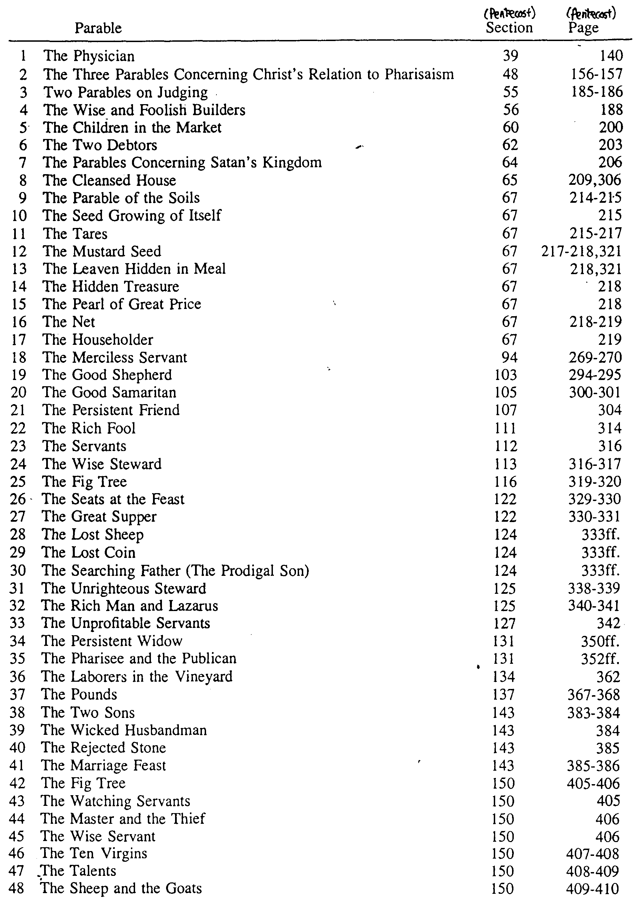
The Parables of Christ
62
J. Dwight Pentecost, A Harmony of the Words and Works of Jesus Christ (Grand Rapids: Zondervan, 1981), 587-88

Slide 42
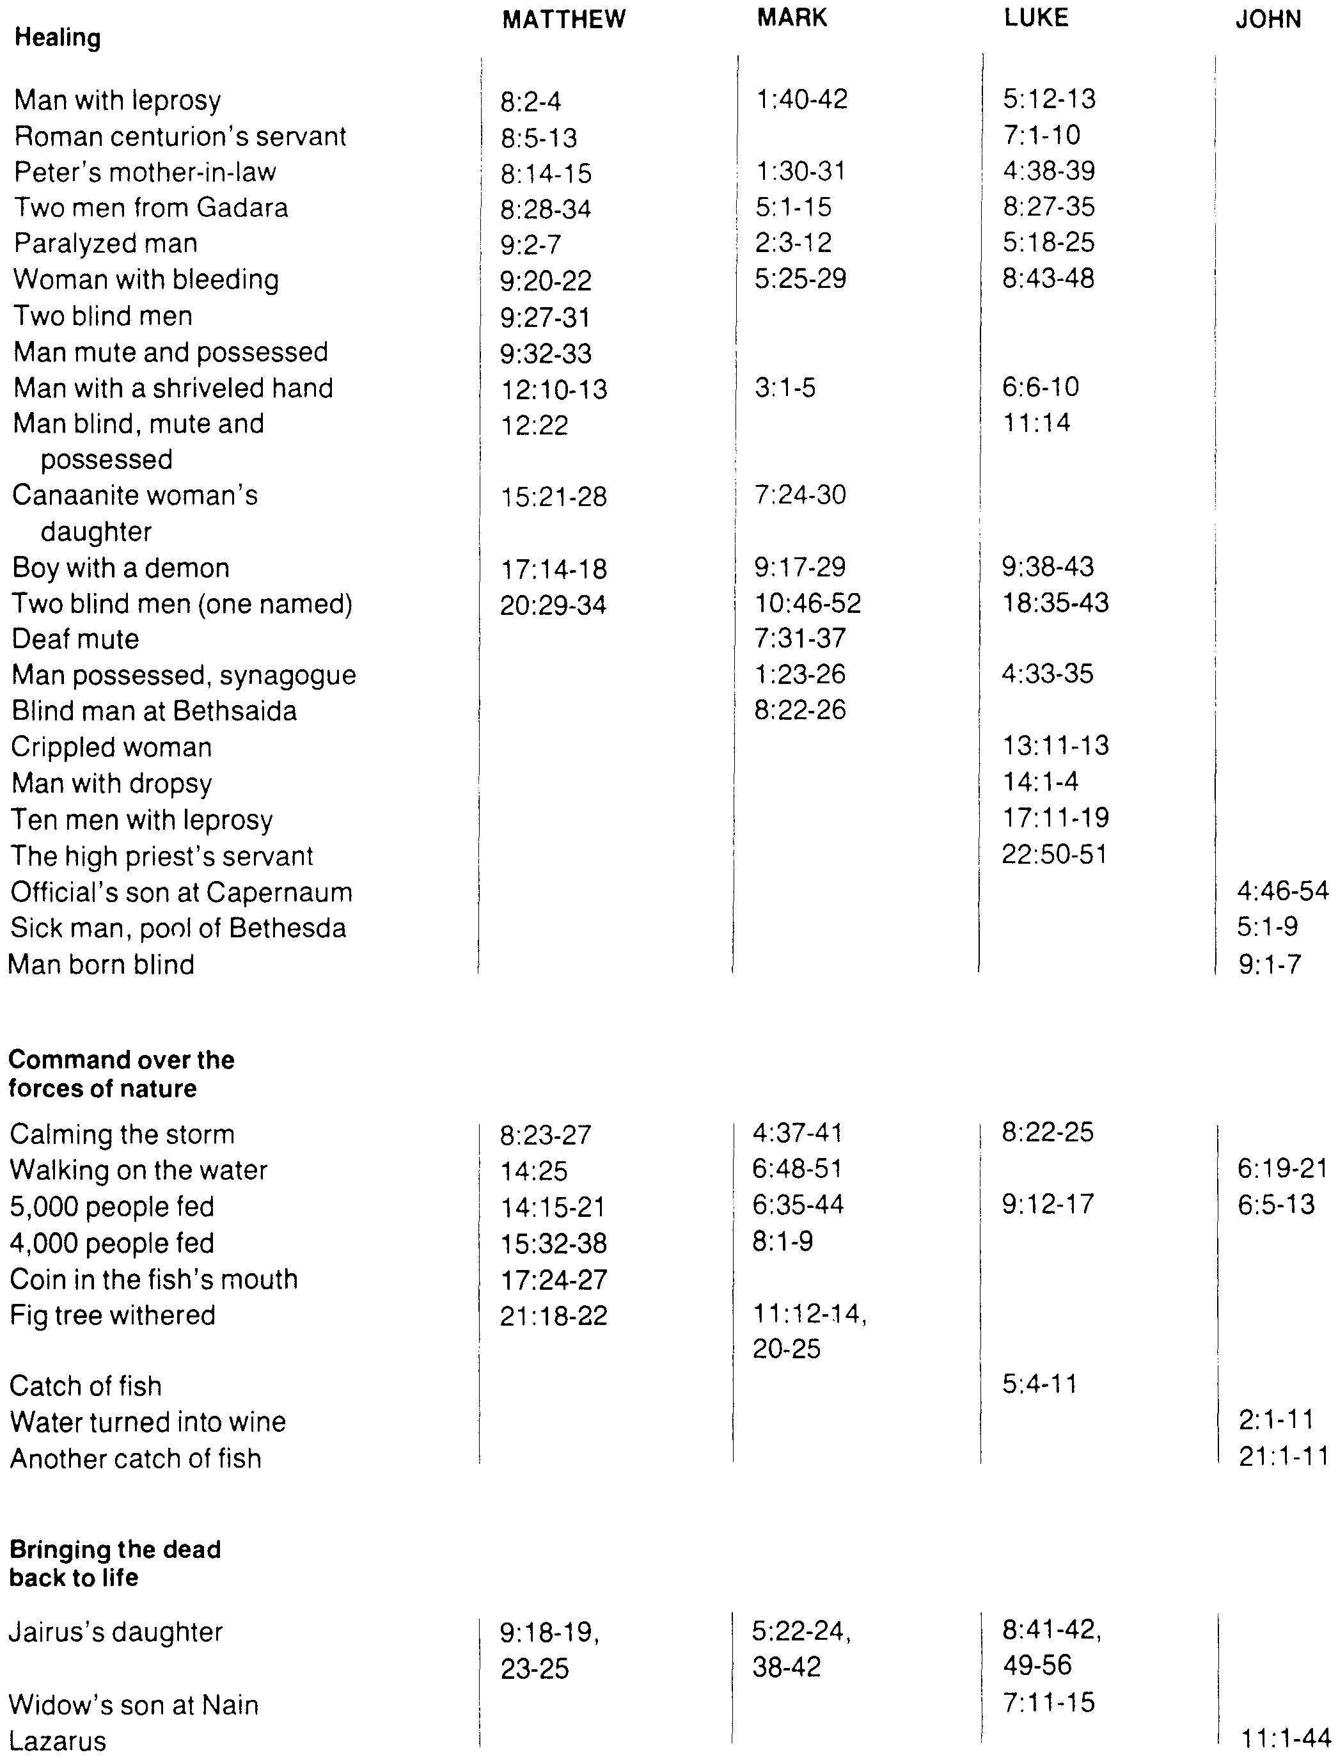
Miracles of Jesus
63
From The Bible Visual Resource Book, 209

Slide 43

Passion Week
Mon
Tues
Wed
64
Fri
Thurs
Sun
Fri
Sat
Sat
Sun

Slide 44
The Jewish Trials of Jesus
65
TRIAL | LEADER | TEXTS | ACCUSATIONS | LEGALITY | TYPE | RESULT
1. | Annas, ex-high priest of Jews (A.D. 6-15) | John 18:13-23 | Trumped-up charges of irreverence to Annas. General questioning, nothing specific. | ILLEGAL! Held at night Prejudice No specific charges Violence | Jewish and Religious | Found "guilty” of irreverence and rushed to Caiaphas
2. | Caiaphas and Sanhedrin (Caiaphas was Annas' son-in-law) (A.D. 18-36) | Matt. 26:57-68 Mark 14:53-65 Luke 22:54, 63-65 John 18:24 | Claimed to be the Messiah, Son of God … blasphemy! | ILLEGAL! Held at night False witnesses Violence Prejudice | Jewish and Religious | Declared guilty of blasphemy and rushed to Sanhedrin (Jewish supreme court)
3. | Sanhedrin (70 Jewish rulers) whose word was needed before He could be taken to Romans | Matt. 27:1 Mark 15:1 Luke 22:66-71 | Claimed to be Son of God Charged with blasphemy! (Worthy of death under Jewish law) | ILLEGAL! Kangaroo Court Accusation switched No witnesses Improper voting | Jewish and Religious | Declared guilty of blasphemy and rushed to Roman official, Pilate

Slide 45
The Roman Trials of Jesus
65
TRIALS | LEADERS | TEXTS | ACCUSATIONS | LEGALITY | TYPE | RESULT
4. | Pilate, governor of Judea (already in "hot water" with Rome) (A.D. 26-36) | Matt. 21:11-14 Mark 15:2-5 Luke 23:1-7 John 18:28-38 | Accused Him of treason. Changed accusation, since reason was worthy of capital punishment in Rome. | ILLEGAL! Kept under arrest, though found innocent. No defense attorney. Violence. | Roman and Civil | Found to be INNOCENT . . . but rushed to Herod Antipas. Mob overruled Pilate . . .
5. | Herod Antipas, governor of Galilee (4 B.C.-A.D. 39) | Luke 23:8-12 | No accusation made. Mock trial. Mob violence. | ILLEGAL! No grounds. Mockery in court-room. Violence. No defense attorney | Roman and Civil | Mistreated and mocked, returned to Pilate without decision made by Herod
6. | Pilate (Second time) | Matt. 27:15-26 Mark 15:6-15 Luke 23:18-25 John 18:39-19:16 | Treason (but not proven) Bargain with mob . . . put on level with Barabbas, a criminal. | ILLEGAL! Pilate, without proof of guilt, allowed innocent man to be condemned | Roman and Civil | Flogged without evidence; Found innocent but Pilate "washed hands" and allowed Him to be CRUCIFIED.

Slide 46
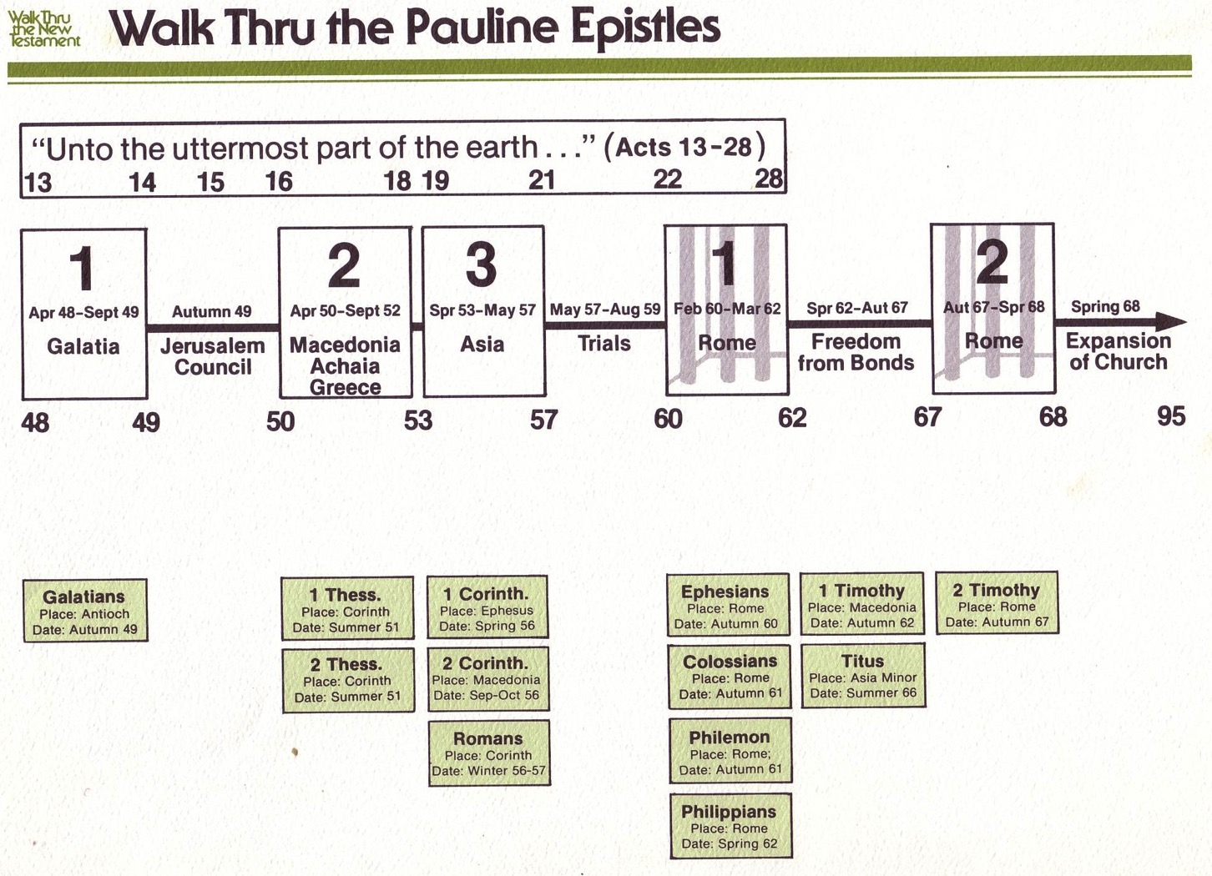
Walk Thru the Pauline Epistles
143

Slide 47
Walk Thru the Pauline Epistles
143
Missionary
Prison
Pastoral

Slide 48
NT Overview
38
124
39-41
"To the remotest part of the earth" (Acts 1:8)
Acts 9 13 14 15 16 18 21 27 28
Apr 48-
Sep 49
1
Galatia
Apr 50-
Sep 52
2
Aegean
Spr 53-
May 57
3
Asia
Feb 60-
Mar 62
1
Rome
Spr 62-
Fall 67
4
Spain
Aut 67-
Spr 68
2
Rome
Summer 35-
37
Damascus
Antioch
May 57-
Aug 59
Trials
Fall 49
The
Council
Spring 68
Expansion of Church
35 48 49 50 52 53 57 60 62 67 68 95
Matt
Luke
Acts
Mark
John
Gal
1 Thess
1 Cor
Eph
1 Tim
2 Tim
Jude
James
2 Thess
2 Cor
Col
Titus
Heb
1 John
Romans
Philem
1 Pet
2 John
Gospels & Acts
Phil
2 Pet
3 John
Pauline Epistles
1234
Journeys
Rev
General Epistles
Rome
Imprisonments
No Animations

Slide 49
NT Book Key Words
24
Date | Book | Key Word | Paul's Life | Key Doctrine
40s | Matthew | Kingdom |  | Ecclesiology
44-47 | James | Works |  | Soteriology
49 | Galatians | Justification | 1st journey | Soteriology
51 | 1 Thessalonians | Rapture | 2nd journey | Eschatology
51 | 2 Thessalonians | Tribulation | 2nd journey | Eschatology
56 | 1 Corinthians | Sanctification | 3rd journey | Ecclesiology
56 | 2 Corinthians | Apostleship | 3rd journey | Ecclesiology
56-57 | Romans | Righteousness | 3rd journey | Soteriology
57-59 | Luke | Sovereignty I |  | Missiology

Slide 50
NT Book Key Words
24
Date | Book | Key Word | Paul's Life | Key Doctrine
60 | Ephesians | Unity | 1st imprisonment | Christology (Head)
61 | Colossians | Deity | 1st imprisonment | Christology (God)
61 | Philemon | Forgiveness | 1st imprisonment | Christology (Reconciler)
62 | Philippians | Attitude | 1st imprisonment | Christology (Example)
62 | Acts | Sovereignty II |  | Missiology
62 | 1 Timothy | Order | 4th journey | Ecclesiology
64 | 1 Peter | Suffering |  | Eschatology
64 | 2 Peter | Knowledge |  | Eschatology
64-68 | Mark | Discipleship |  | Eschatology

Slide 51
NT Book Key Words
24
Date | Book | Key Word | Paul's Life | Key Doctrine
66 | Titus | Conduct | 4th journey | Ecclesiology
67 | 2 Timothy | Doctrine | 2nd imprisonment | Ecclesiology
67-68 | Hebrews | Superiority |  | Christology
c. 69 | John | Belief |  | Soteriology
75 | Jude | Pretenders |  | Eschatology
85-95 | 1 John | Love |  | Soteriology
85-95 | 2 John | Limits |  | Missiology
85-95 | 3 John | Missionaries |  | Missiology
95-96 | Revelation | Triumph |  | Eschatology

Slide 52
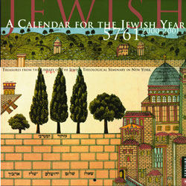

Jewish Calendars
OTS
221
Civil
Sacred
Numbered

Slide 53

Hebrew Calendars
The Exodus Night:
While the Israelites were still in the land of Egypt, the LORD gave the following instructions to Moses and Aaron: ²"From now on, this month will be the first month of the year for you" (Exod. 12:1-2)
OTS
221
1 Nisan
2 Iyar
3 Sivan
4 Tammuz
5 Av
6 Elul
7 Tishri
8 Cheshvan
9 Kislev
10 Tevet
11 Shevat
12 Adar
Mar-Apr
Sacred Calendar Begins
Civil Calendar Begins
Sep-Oct

Slide 54
Hebrew Calendars
Which system did they use to determine the king's reign?
Israel began
with Nisan
& didn't count
accession year
OTS
221
1 Nisan
2 Iyar
3 Sivan
4 Tammuz
5 Av
6 Elul
7 Tishri
8 Cheshvan
9 Kislev
10 Tevet
11 Shevat
12 Adar
Mar-Apr
Did they count the accession year?
Sacred Calendar Begins
Two Key Issues:
Civil Calendar Begins
Judah began
with Tishri
& counted
accession year
What if the
king's reign
began here?
Sep-Oct

Slide 55


NT Survey link at BibleStudyDownloads.org
Get this presentation for free!
Notes:
NT Survey (ns)

Slide 56
Black

